Slide 1

Our School
Complex of Primary School No. 2 and Kindergarten in Zagnańsk

Slide 2

School History
In 1999. The Primary School No. 2 and Junior High School Complex in Zagnańsk are established. Two years later, Jadwiga Krawiec became the Headmaster of the institution.
In 2004, a kindergarten was added to the primary and secondary schools, and a year later Marzanna Moćko became the school's Headmaster.
On July 12, 2007, the Commune Council adopted the "Resolution on giving the name of Stanisław Staszic to the Primary School Complex No. 2, Kindergarten and Junior High School in Zagnańsk".
On August 5, 2008, the ceremony of naming the school after Stanisław Staszic and the blessing of the new school banner took place.
On June 1, 2011, the ceremonial opening of the new kindergarten and the connector with the sports hall takes place.
On December 19, 2011, the jubilee celebrations of the „Dwójka” ("Two„) in Zagnanńsk took place. Unveiling of a commemorative plaque dedicated to the first headmaster of the school – Stanisław Kubicki.

Slide 3
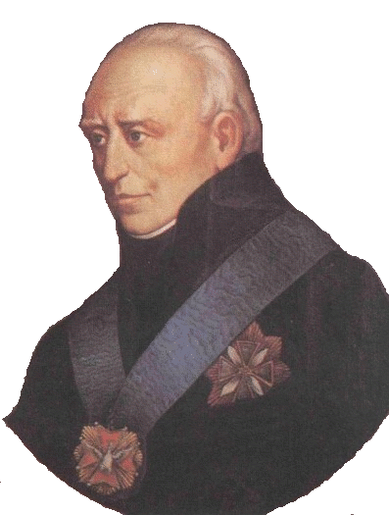
Our Patron
The patron of Primary School No.2 in Zagnańsk is Stanisław Staszic, an outstanding Polish philosopher, scientist and politican, representing the Enlightenmment. His scintific works and social activities had a huge inpact on the development of science in Poland. Our School draw inspiration from his achievements to promote knowledge, develop talents and shape civic education that the school imparts to its students.
https://www.zsp1.siedlce.pl/szkola/historia/patron-szkoly

Slide 4

"changes lives, opens minds"
The Complex of Primary School No. 2 and Kindergarten in Zagnańsk is the only school in the municipality of Zagnańsk that has been implementing European student and teacher exchange projects since 2008 - first under the Comenius Lifelong Learning Programme, and now under the Erasmus Plus programme.
120 students and teachers
Participated
On foreign visits
PLN 450,000 in funding
obtained through the implementation of projects

Slide 5
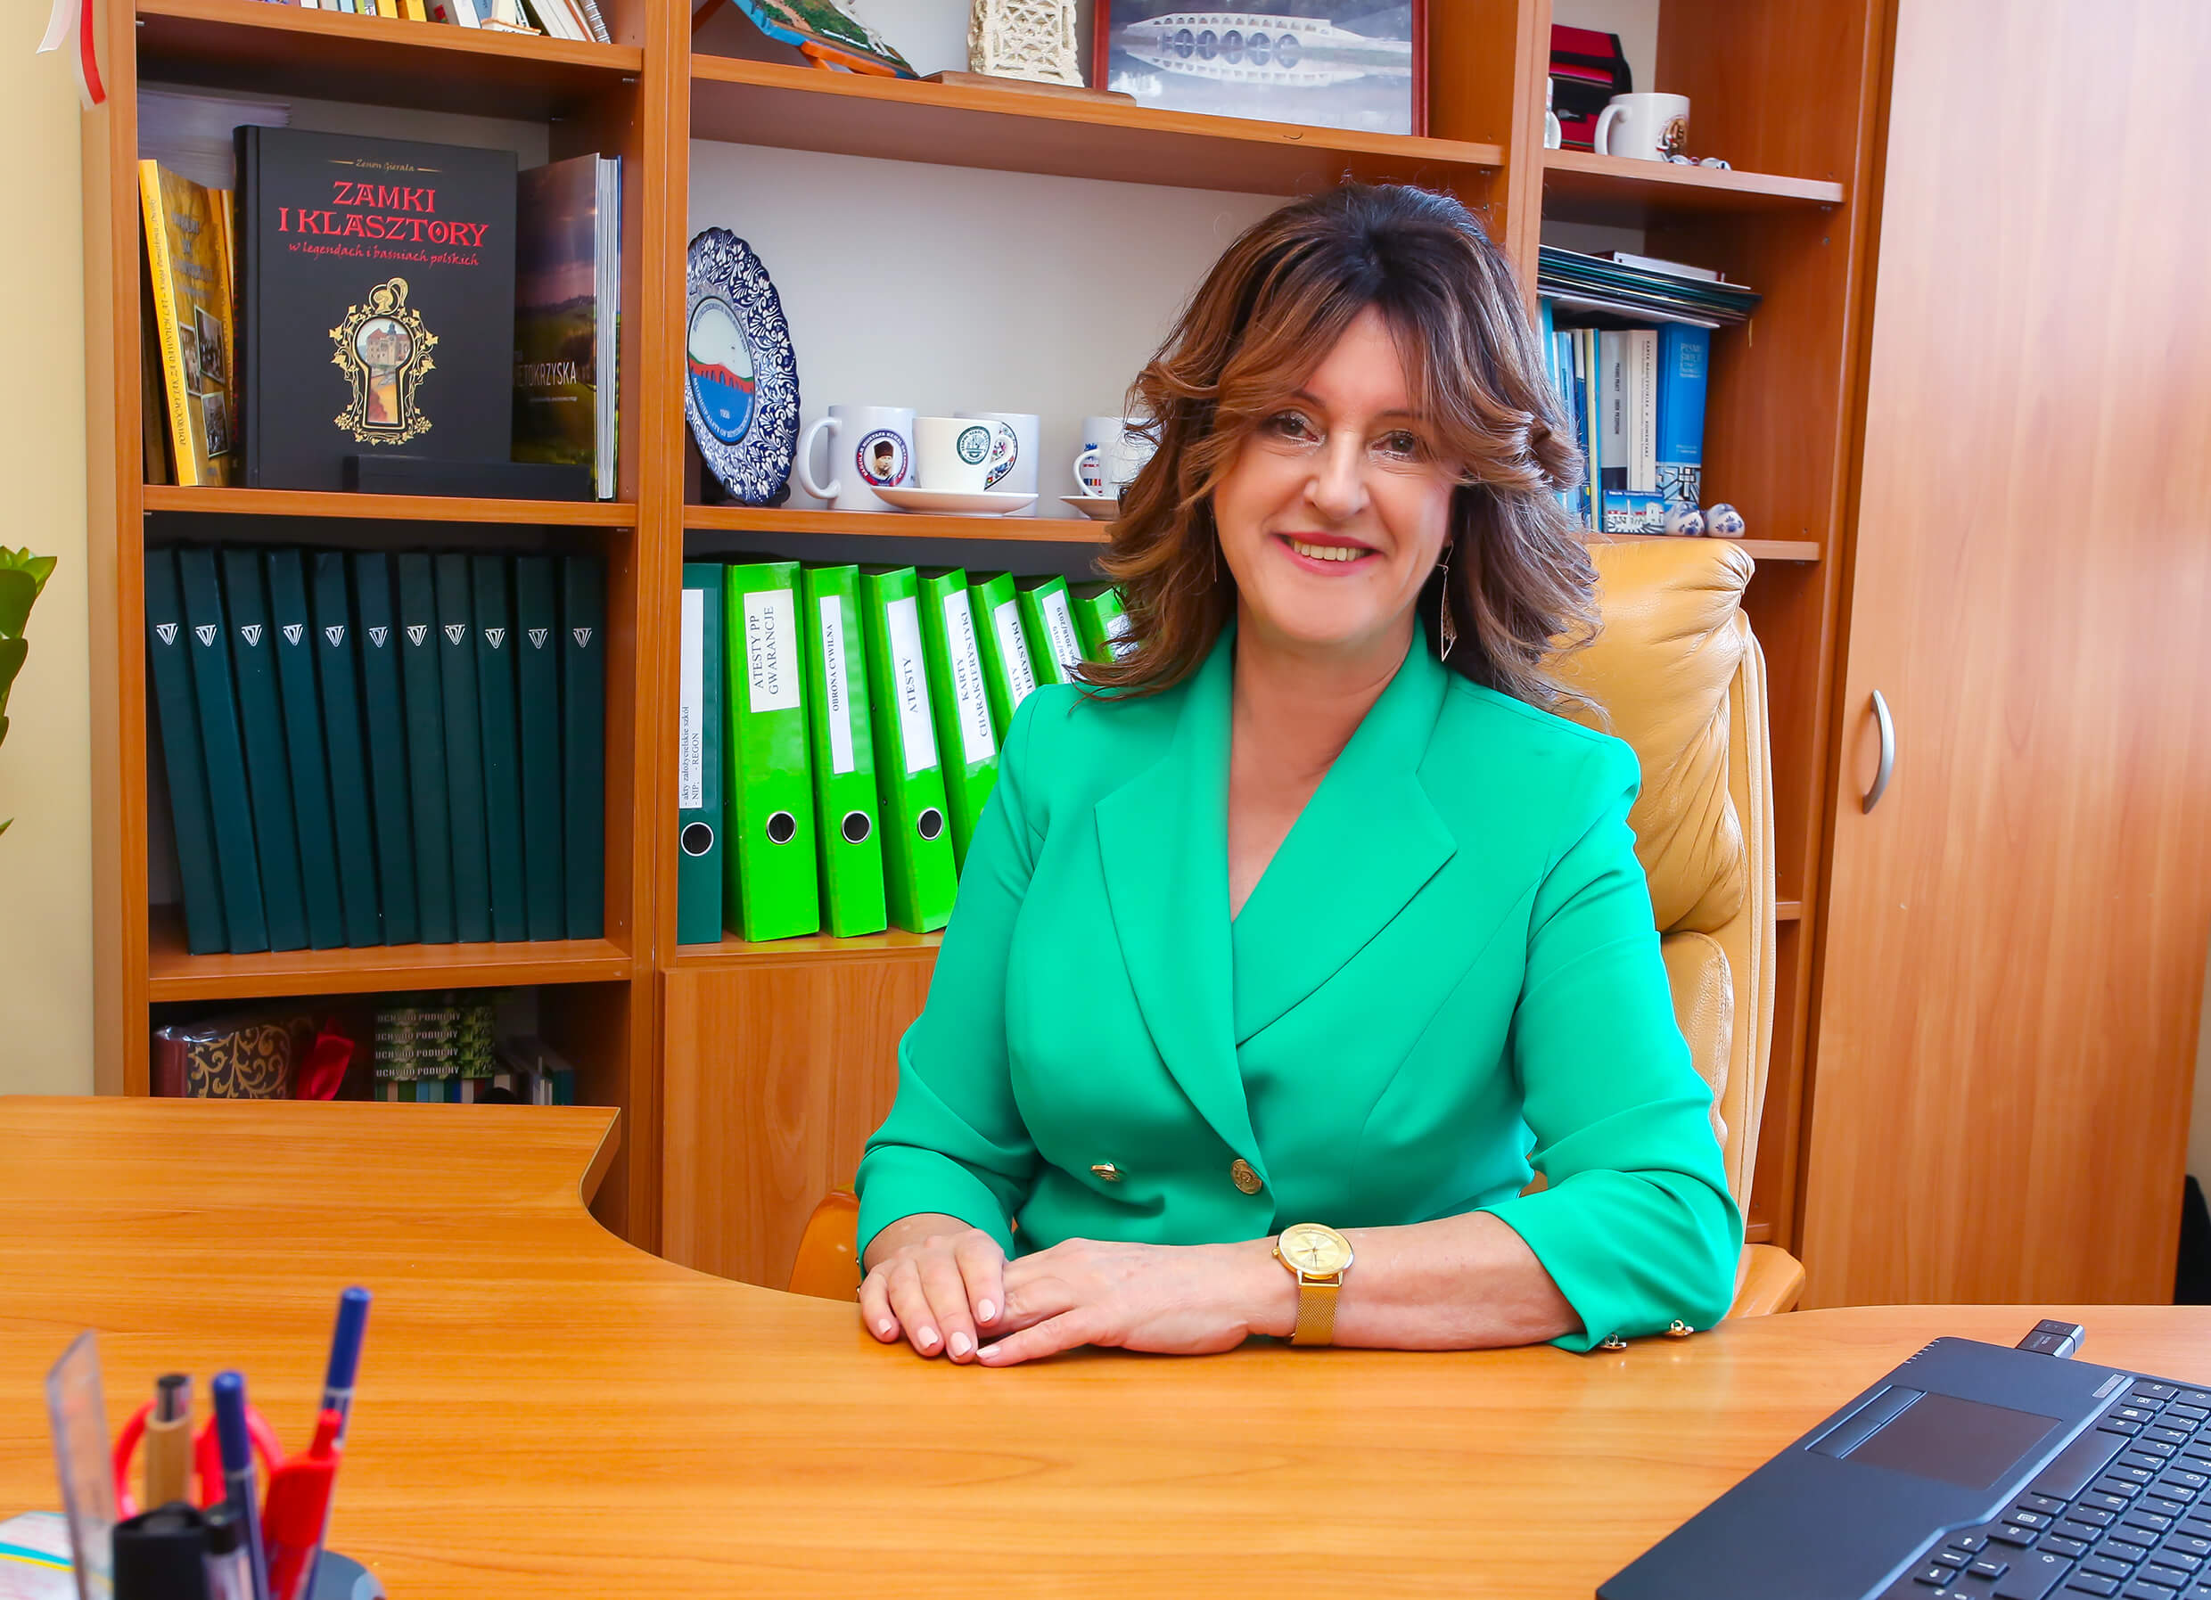
Cadre
Teaching staff
Marzanna Moćko
Headmaster
Beata Wojtuk-Ślęk
Deputy Head

Slide 6
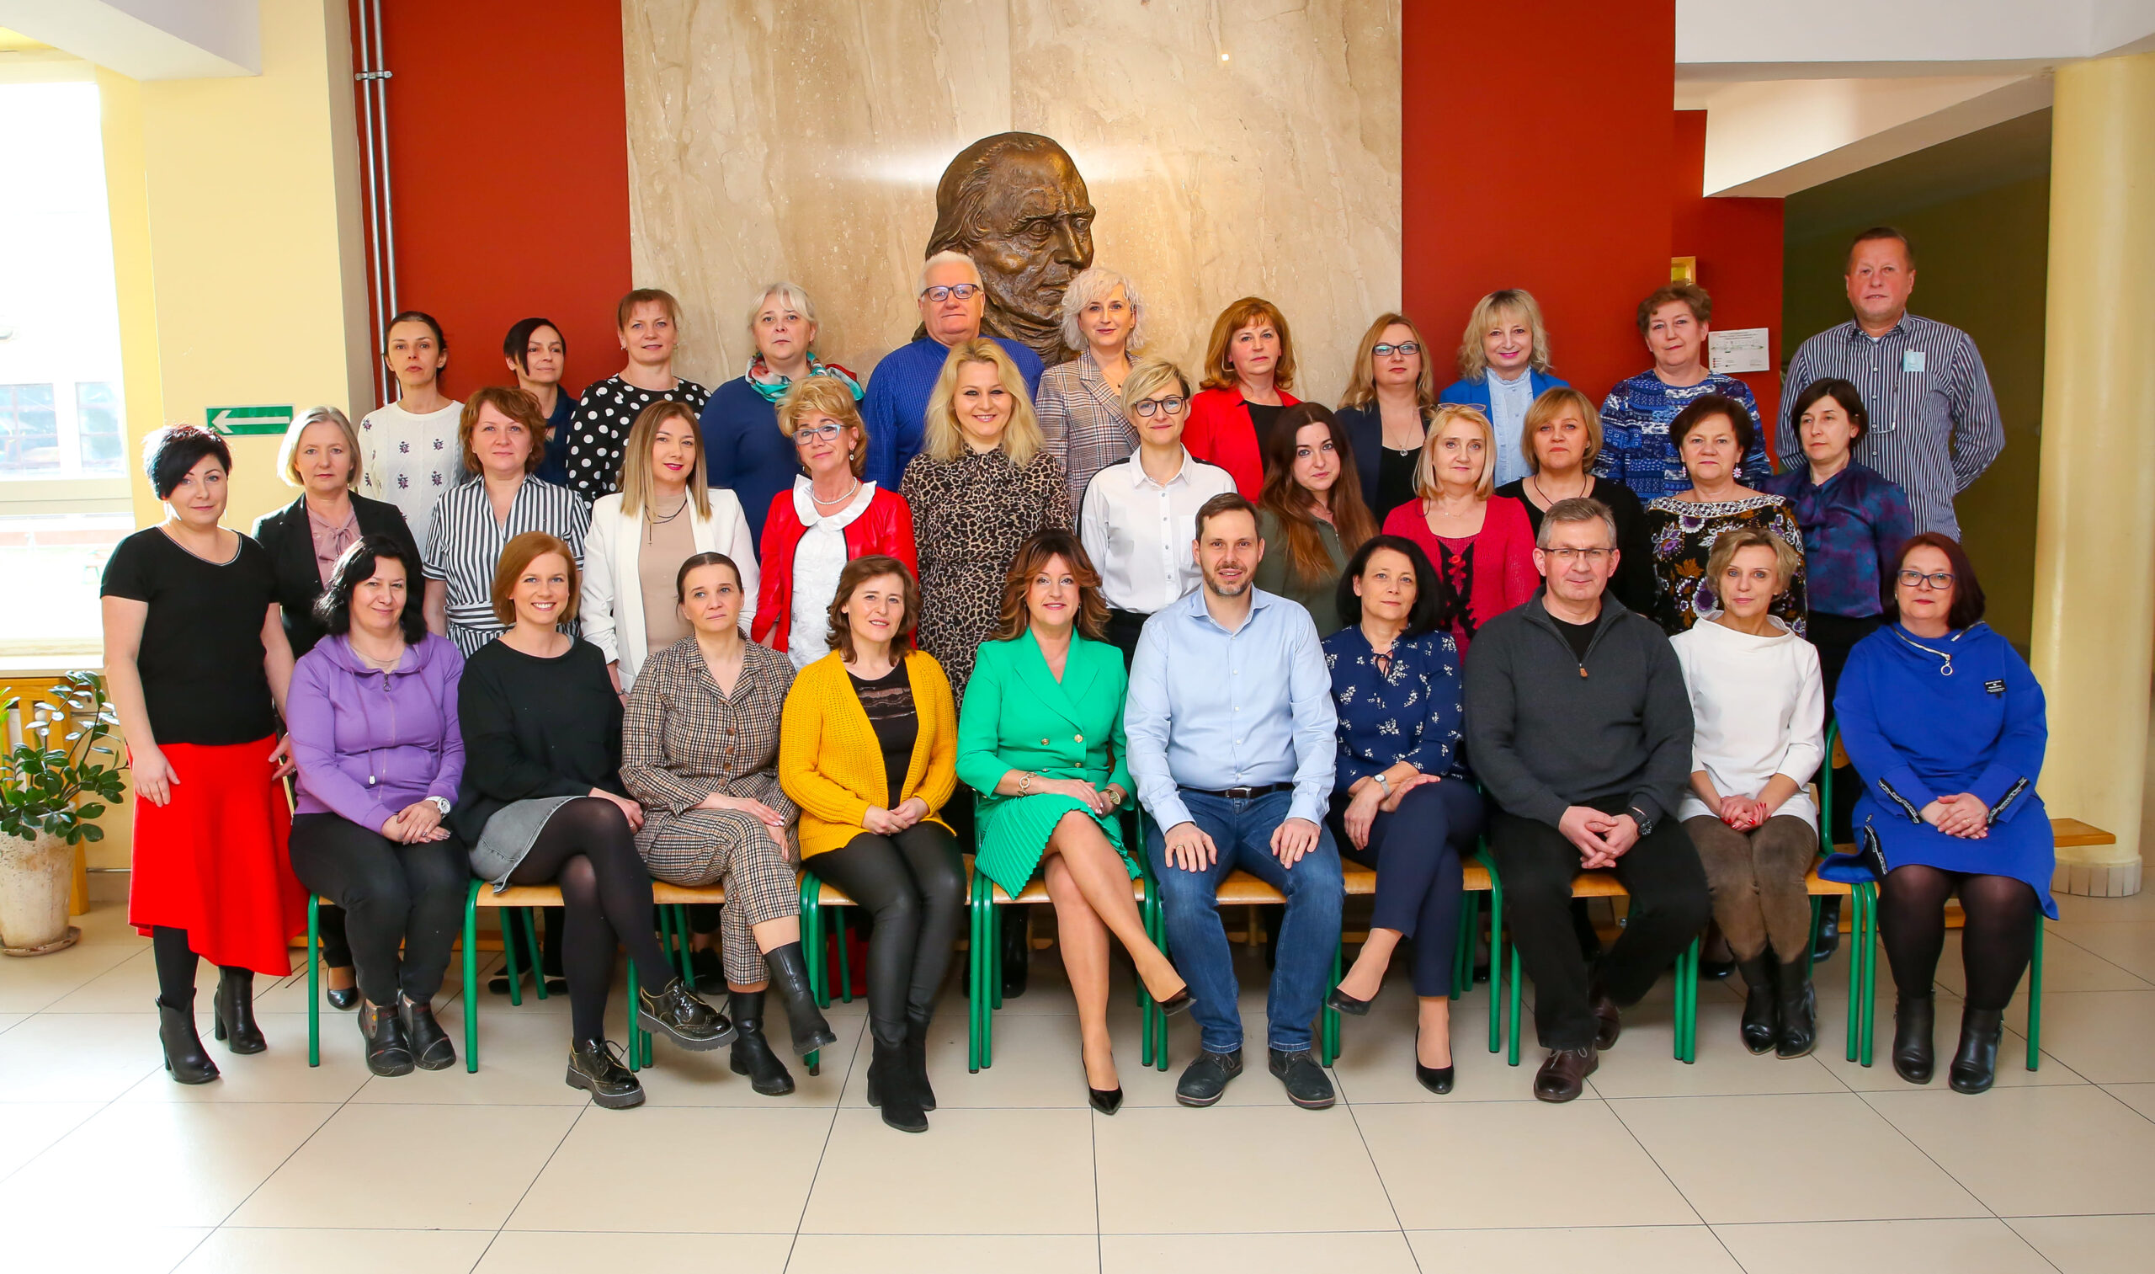
Teaching Staff
The Teaching staff of primary school No.2 in Zagnańsk includes teachers with appropriate education and experience in working with children. this group includes teachers of various subjects such as mathematics, polish, geography, biology, chemistry, foreign laguages, art, music, psychical education and others. Additionally, special educators, speech therapists, psychologists and other people supporting students in thier development and education work at the school No.2 in Zagnańsk focuses on ensuring high quality teaching and comprehensive development of each student.

